Slide 1
Using machine learning approaches to characterize major depressive disorder (MDD)
Zeng, Ling-Li, et al. "Identifying major depression using whole-brain functional connectivity: a multivariate pattern analysis." Brain 135.5 (2012): 1498-1507.
Lord, Anton, et al. "Changes in community structure of resting state functional connectivity in unipolar depression." PLoS One 7.8 (2012): e41282.

Slide 2
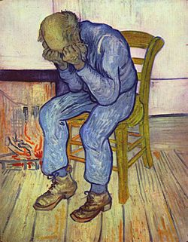
Major depressive disorder (MDD)
A mental disorder
Episodes of low mood, low self-esteem, fatigue, cognitive impairments, and loss of interest in normally enjoyable activities (anhedonia)
Affects family, work or school life, sleeping and eating habits and general health
Most common time of onset is between the ages of 20 and 30 years
Vincent van Gogh's 1890 Sorrowing old man

Slide 3
MDD Diagnosis
Self-reported experiences
Behavior reported by relatives or friends
Questionnaires. Gold standard: Hamilton scale for depression (HAM-D)*
Tests for physical conditions that may cause similar symptoms
Miss diagnosis by primary care physicians: 65% false negatives and almost 20% false positives
Notes:
Until recently, the ‘gold standard’ for assessing depression was the Hamilton scale for depression (HAM-D). However, recent evidence suggests that the HAM-D may be psychometrically and conceptually flawed [6], arguing that a fundamental reassessment of this gold standard is needed.

Slide 4
Data
Resting state (eyes closed) fMRI data from 24 depressed patients and 29 demographically matched healthy controls (Zeng et. Al)
Resting state (eyes closed) fMRI data from 21* depressed patients and 22 healthy controls (Lord et. Al) with no significant age/gender diffs
Notes:
* After excluding one depressed female due to excessive head movements

Slide 5
Preprocessing
SPM5
Head motion correction
Normalizing to the standard space (MNI)
Spatial smoothing (only Zeng et. Al)
Linear trend removal
Band-pass filter (0.01–0.08 Hz) (only Zeng et. Al)
Removal of global mean, white matter mean and cerebrospinal fluid mean signals (only Lord et. Al)

Slide 6
Feature extraction – Zang et. Al.
Used the automatic anatomic labeling (AAL) atlas -> 90 cerebral and 26 cerebellar regions
For each region mean signal was calculated
Pearson correlation coefficient was calculated for each region pair (number of region pairs: (116*115)/2 = 6670)

Slide 7
Feature extraction – Lord et. Al.
Used a modified version of the AAL atlas -> only 95 cerebral regions*
For each region mean signal was calculated
Pearson correlation coefficient was calculated for each region pair (number of region pairs: 95*94/2=4465)
Correlation values adjusted according to inter-regional distances
G(V,E), where V= AAL regions, and edges are weighted according to spatially adjusted pairwise correlations
Several graph metrics were calculated
Notes:
Lord et. Al. used a modified version of AAL, version of the automatic anatomic labeling (AAL) atlas containing a higher level of parcellation for the cingulate cortex [45–47] and insular cortex (anterior and posterior insula [48]). In contrast to the original AAL template where the cingulate regions are separate for left and right hemisphere, we combined both sides to finally obtain regions that stretch across the midline of the brain. leads to 95 instead of originally 90 regions of interest (ROI).

Slide 8
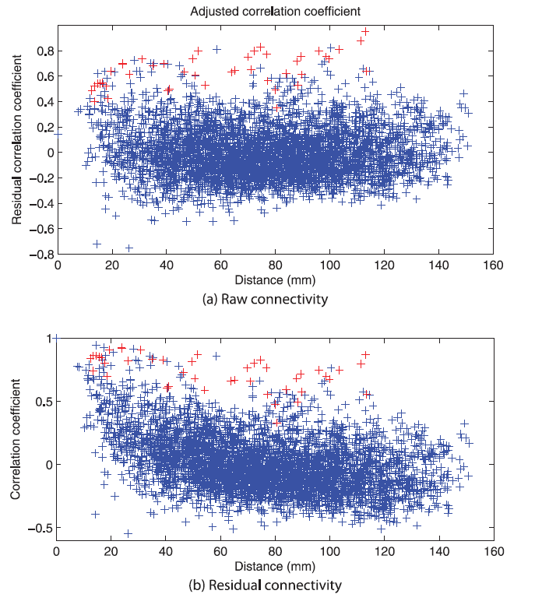
Notes:
Entries marked in red denote bilateral connections between the same region, e.g. Hippocampus left and right

Slide 9
Graph metrics elaboration
Community structure (Rubinov& Sporns Neuroimage 2011) partition into non-overlapping modules where
Positively weighted connections are - same module
Negatively weighted connections - distinct modules
The modularity algorithm produces a goodness of fit score (Q) for every possible community structure
Notes:
The PI of a given node is dependent on its connectivity and the modularity decomposition of the entire network. The modularity algorithm produces a goodness of fit score (Q) for every possible community structure.
There are, in fact, a multitude of modular decompositions for each subject with near optimal goodness of fit (Q) scores. For a single subject, it is sufficient to find the single decomposition with the highest Q score and calculate the node-wise PIs using this structure.
This work tested for group differences in the PI of individual nodes for clinical versus control subjects – I will not refer to this but rather to the second issue of using graph metrics for classification

Slide 10
Modularity Algorithm
Notes:
Q+ = pos weights contribution
Q- = neg weights contribution
Empirically, high-Q− modularity partitions are objectively less optimal than high-Q+ modularity partitions

Slide 11
Graph metrics calculations– Lord et. Al.
Node Participation Index (PI) - measures connectivity relative to the graph’s modularity decomposition
M – set of modules
Ki - # of edges connecting node i Ki(s) - # edges from i within s
A low PI → more connections within same module A high PI → more external connections
Path length (PL) - average distance between all node pairs
Betweenness centrality (BC) - # shortest paths traversing a given node
Clustering coefficient (CC) – reflects local cliques tendency
Small world index - the ratio between CC and PL
Local and Global efficiency (LE,GE)
Notes:
PI:
M = the set of modules
ki = number of edges connected to node i
ki(s) = # edges within module s.
Nodes with a low PI share connections with other members of the same module, whereas those with a high PI serve as connectors between modules. In all subsequent analysis, the PI scores have been rank-ordered from lowest to highest PI within each individual to remove inter-subject variance. That is, a node with the lowest PI is assigned as rank 1 whilst that with the highest PI (the strongest ‘‘connector’’) is ranked 95
Thresholding was performed at 12% based on prior analysis that found that such sparsity was close tooptimal in terms or retaining the most informative network edges whilst ensuring that disconnection is rare. No negative connections were retained after thresholding. Any edge that would cause the graph to disconnect by its removal was retained, even in the case of a low weight
local and global efficiency (LE and GE) which captures the information capacity of the network considered as a distributed, parallel system [52]. Together these metrics capture the basic topological features of the whole brain functional connectivity. In order to control for any putative differences in overall connection strength, each metric was normalized (subject-wise) to reference random graphs.
To identify modules (communities) within each network, we apply a variant of a spectral community detection algorithm [41]. As inputs to the algorithm we used matrices of matching indices [6], which express the similarity of connection patterns for each pair of vertices (Figure 1). Once modules were detected, different solutions were ranked according to a cost function and the optimal modularity (out of 10000 solutions for a range of between 2 and 6 modules) was used as the basis for hub classification. To classify hubs we calculated each vertex's participation index P [28], [42], which expresses its distribution of intra- versus intra-module connections. Pi FORMULA - where N_{M} is the number of identified modules, k_{i} is the degree of node i, and κ_{is} is the number of edges from the ith node to nodes within module s.
Considering only high-degree vertices (i.e. vertices with a degree at least one standard deviation above the network mean) we classify vertices with a participation coefficient P<0.3 as provincial hubs, and nodes with P>0.3 as connector hubs. Since P cannot exceed 0.5 for two-module networks and 0.67 for three-module networks, kinless hubs (i.e. nodes with P>0.8 [32c]) cannot occur in these mammalian cortical networks.

Slide 12
Graph metrics elaboration
Global efficiency:
Local efficiency – mean of efficiencies of all subgraphs G_{i} of neighbors of each of the vertices of the graph
Notes:
Latora and Marchiori have proposed a framework to address some of these problems [41,42,48]. They consider weighted networks and define the efficiency of the path between two vertices as the inverse of the shortest distance between the vertices (note that in weighted graphs the shortest path is not necessarily the path with the smallest number of edges). In the case where a path does not exist, the length is considered to be infinite, and the efficiency is zero. The average over all pair wise efficiencies is the Global efficiency E_{glob} of the graph:

Slide 13
Graph metrics elaboration
Clustering coefficient
Notes:
Local – number of triangles divided by number of triplets
Global – average over all nodes

Slide 14
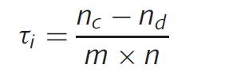
Feature selection - Zang et. Al.
Used Kendall tau correlation:
n_{c} = # concordant pairs n_{d} = # discordant pairs
m = # cases, n = #controls
Concordant: sgn(r_{i(j)-}r_{i(k)}) = sgn(y_{(j)-}y_{(k)})
Discordant: sgn(r_{i(j)-}r_{i(k)}) = -sgn(y_{(j)-}y_{(k)})
r_{i(j)} – the i^{th} correlation of the j^{th} subject
y_{(j)} – class of subject j (1 for cases -1 for controls)
Notes:
Thus, a positive Ƭi indicates that the ith functional connectivity coefficient increases in the patient group compared
to the control group. A negative i indicates that the ith functional connectivity coefficient decreases in the patient group. The discriminative
power was defined as the absolute value of the Kendall tau correlation coefficient.
The discriminative power was defined as the absolute value of the Kendall tau correlation coefficient. We subsequently ranked features according to their discriminative powers and selected those with coefficients over a threshold as the final feature set for classification.
Took 550 top features since they produced 100% accurqacy in the training set (overfitting??)

Slide 15
Feature selection – Lord et. al
Initially ,all graph metrics described previously were defined as features
Minimum redundancy, maximum relevance (mRMR) algorithm
Incremental algo
S= set of features
I (xi;c)=mutual information between feature i and class c
I (xi,xj)=mutual information between features i and j
Notes:
We identified, in each subject, the single decomposition with the best Q score. Node-wise PI values were then extracted using each subjects best modularity decomposition
The largest mutual information with the target class c, reflects the largest dependency on the target class.
The minimum redundancy, maximum relevance (mRMR) algorithm [57] uses information about each features individual predictive power, as well as the amount of mutual information with other features that have been selected to define a list of the most relevant features. mRMR produces results similar in accuracy to an exhaustive search, without the increase in time cost for ordering the feature list. Due to the combination of low computational cost, as well as high accuracy, mRMR was used for feature selection, with the results compared to a list produced by recursive feature elimination (RFE) [58].
In practice, incremental search methods can be used to find the near-optimal features defined by φ.

Slide 16
Mutual information
Given two random variables x and y, their mutual information is defined in terms of their probabilistic density functions p(x), p(y), and p(x, y):

Slide 17
Classification – Zang et. al
Linear kernel SVM
Leave one out cross validation (LOOCV)
Significance evaluation: 10000 label permutations
Searched for “consensus FCs” - features selected for all cross-validation iterations
Regions were assigned weights according to participation in consensus FCs
Consensus FC power – average discriminative powers across all CV iterations
Notes:
Consensus functional connectivity was introduced here, which was defined as the functional connectivity fea-ture appearing in the final feature set of each cross-validation iteration – why not just select top ranking features?
Region weight, representing the relative contribution to identification of depressed patients, was denoted by its occurrence number in the consensus functional connections in this study.
The consensus functional connectivity discriminative power was denoted by the average of its discriminative powers across all iterations of the cross-validation.

Slide 18
Classification – Lord et. al
Data randomly split into 50% train and 50% test (reshuffled 1000 times – bagging technique, a special case of model averaging)
Random splits where the cases/controls ratio was > 70% or < 30% were discarded
Random label permutations (both prior and post training)
Linear kernel SVM
Notes:
Bagging was used to improve robustness
Bootstrap aggregating (bagging) is a machine learning ensemble meta-algorithm designed to improve the stability and accuracy of machine learning algorithms used in statistical classification and regression. It also reduces variance and helps to avoid overfitting. Although it is usually applied to decision tree methods, it can be used with any type of method. Bagging is a special case of the model averaging approach.
Given a standard training set D of size n, bagging generates m new training sets , each of size n′ < n, bysampling from D uniformly and with replacement. By sampling with replacement, some observations may be repeated in each . If n′=n, then for large n the set is expected to have the fraction (1 - 1/e) (≈63.2%) of the unique examples of D, the rest being duplicates.^{[1]} This kind of sample is known as a bootstrap sample. The m models are fitted using the above m bootstrap samples and combined by averaging the output (for regression) or voting (for classification).
Bagging leads to "improvements for unstable procedures" (Breiman, 1996), which include, for example, neural nets, classiﬁcation and regression trees, and subset selection in linear regression (Breiman, 1994). On the other hand, it can mildly degrade the performance of stable methods such as K-nearest neighbors (Breiman, 1996).

Slide 19
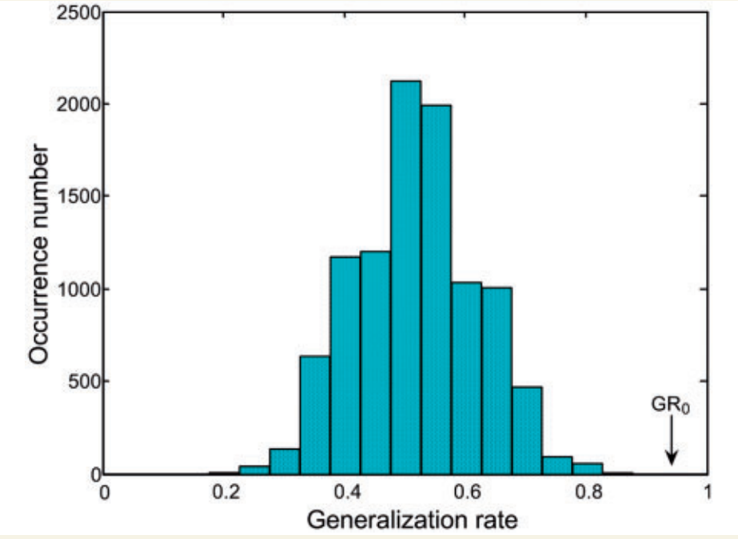
Classification results – Zang et. Al.
Using 550 features, ACC = 94.3% (100% for cases, 89.7% for controls ,P<0.0001)
Generalization rate (GR) distribution in 10000 label permutations
GR₀ - generalization rate obtained by the classifier trained on the real labels.
Notes:
The number 550 is first mentioned in the sentence: “The classification results indicate that the final correct classification rate of the training data set was 100% using the 550 most discriminating functional connections.”
With the generalization rate as the statistic, this figure reveals that the classifier learned the relationship between the data and the labels with a probability of being wrong of<0.0001

Slide 20
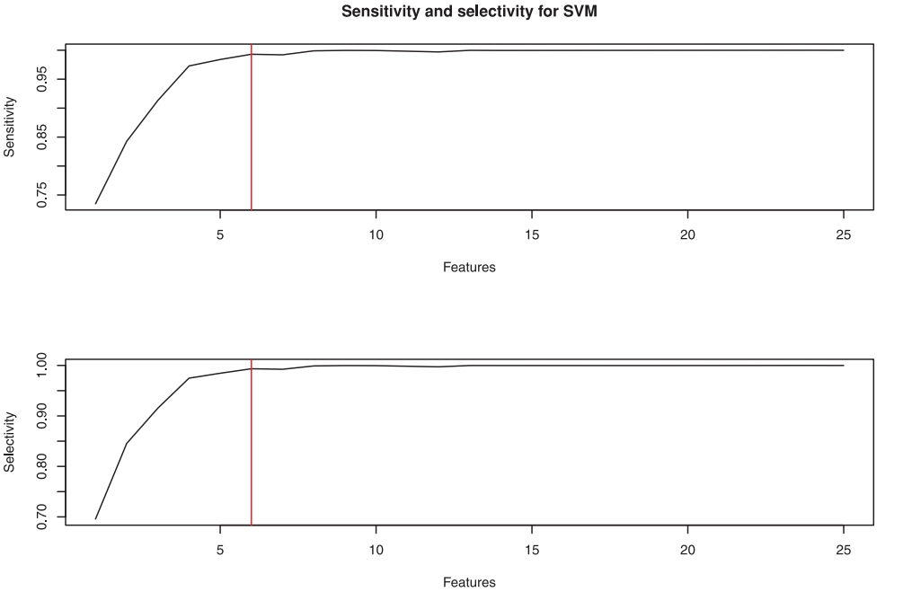
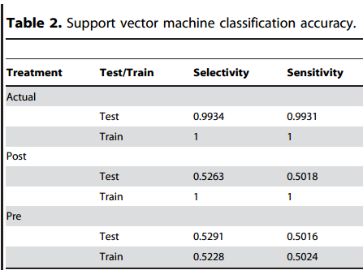
Classification results – Lord et. al
ACC using top 2 features = 90%
ACC using top 6 features > 99%
Notes:
This accuracy was checked by reshuffling training and testing sets 1000 times as well as randomly shuffling labels, both prior and post training
The probability of any one of the graph metrics to occupy 15 or more of the top 25 data features was estimated, through resampling, to be p<1e-6, suggesting that there is a significant restructuring of the modular structure between groups.??
Bagging results for SVM classification accuracy using 6 features and resampling training/testing data 1000 times. Treatment refers to the labeling of the data where ‘Pre’ and ‘Post’ refer to if the data labels were shuffled before or after vector training

Slide 21
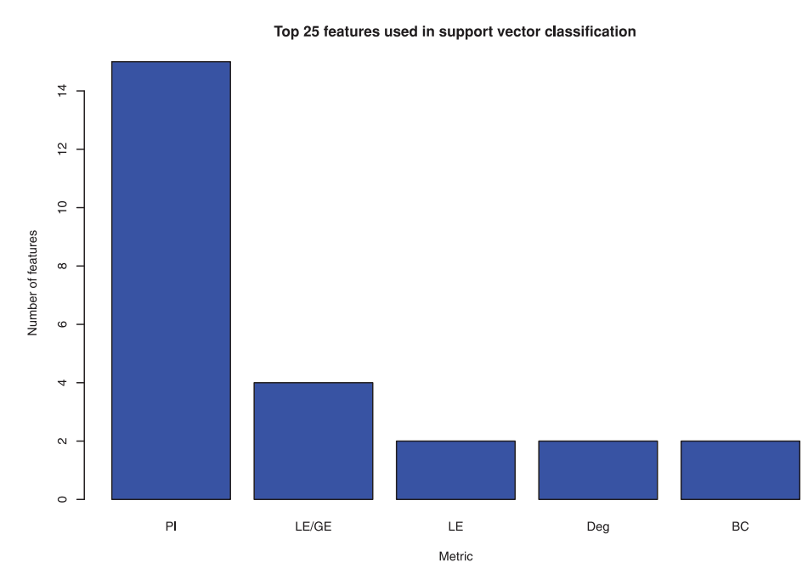
Classification results – Lord et. al
Notes:
Top 25 features for classification using SVM obtained using mRMR.
Metrics included are participation index (PI), local/global efficiency (LE/GE), local efficiency (LE), degree (Deg) and betweenness centrality (BC).

Slide 22
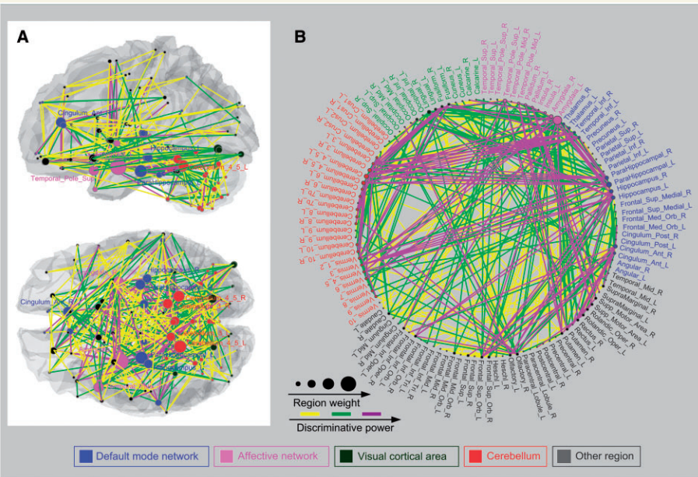
Interpretation – Zang et. al
Notes:
Region weights and the distribution of 442 consensus functional connections. Regions are color-coded by category. The line colors representing the relative consensus functional connections are scaled with their mean discriminative power in the leave-one-out cross-validation. (A) Consensus functional connections demonstrated in left and top view. (B) Region weights and consensus functional connections demonstrated in a circle graph.
In this investigation, 55.4+-1.0% of the selected functional connections in the cross-validation were diminished in depressed patients compared with healthy controls.
442 consensus functional connections were identified in the cross-validation (Fig. 2).
What they refer to as visual contains regions related to various other functions such as motor

Slide 23
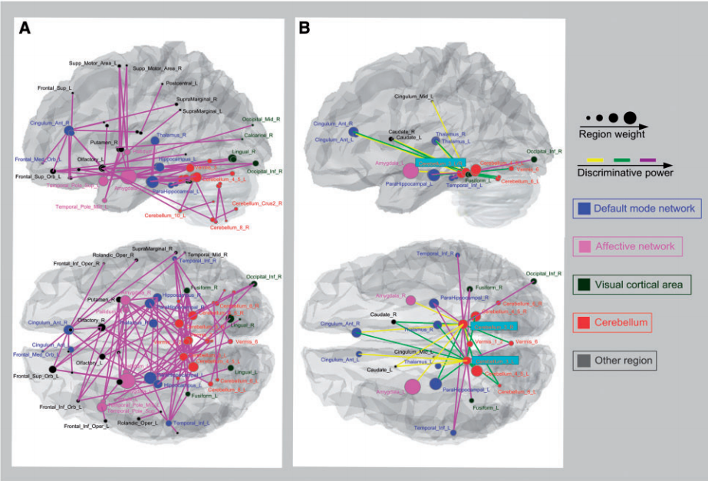
Interpretation – Zang et. al
Notes:
Most discriminating network formed by the top 100 consensus functional connections (A) and the consensus functional connectivity network related to the bilateral cerebellar lobule three regions (B). Labels indicating brain regions are located at their respective centres of mass. Regions are color-coded by category. The line colors representing the relative consensus functional connections are scaled with their mean discriminative power in the LOOCV.
For visual representation, the diameter of a sphere representing a region was scaled by the corresponding region weight (Figs 2and 3). Several brain regions exhibited greater weights than others, i.e. amygdala, anterior cingulate cortex, parahippocampal gyrus and hippocampus.
Amygdala exhibited the highest discriminative power, and the functional connections between this region and the prefrontal lobe, visual cortex, other limbic regions and the cerebellum were altered in major depression.
Abnormal functional connectivity was also observed between the anterior cingulate cortex and other prefrontal lobe, parahippocampal gyrus and cerebellum.
Additionally, functional connections of the parahippocampal gyrus were altered with the inferior temporal gyrus, superior temporal poles, anterior and posterior cingulate cortex, thalamus, fusiform gyrus and cerebellum.
Functional connectivity between the hippocampus and the prefrontal lobe, inferior occipi-tal gyrus, amygdala and cerebellum were altered in depressed patients as well.

Slide 24
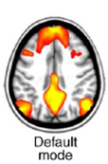
Default mode network (DMN)
A network of brain regions that are most active at rest, i.e., when the individual is not engaged in any task
Deactivated during task
Characterized by coherent neuronal oscillations at a rate lower than 0.1 Hz (one ever ten seconds)
Is implicated as involved in introspection, or self-referential thought

Slide 25
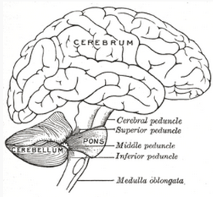
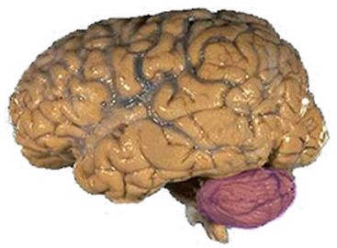
Cerebellum (Latin for little brain)
Plays an important role in motor control (contributes to coordination, precision, and timing)
May also be involved in some cognitive functions such as attention and language
Implicated as involved also in regulating fear and pleasure responses
Receives input from sensory systems of the spinal cord and from other parts of the brain, and integrates these inputs to fine tune motor activity
Notes:
Damage to the cerebellum does not cause paralysis, but instead produces disorders in fine movement, equilibrium, posture, and motor learning

Slide 26
Discussion – Zang et. al
Altered FC of DMN regions known to be involved in self-referential activity
Abnormalities found in affective network RS FC (amygdala and temporal poles exhibit the greatest region weights)
Aberrant visual* cortical areas RS FC
Surprisingly, altered FC observed between the cerebellum and the regions in the DMN and affective network
Notes:
Altered functional connectivity was found to be related to the default mode network with regions known to be involved in self-referential activity (Raichle, 2001; Greicius et al., 2003), such as the bilateral hippocampus/parahippocampal gyrus, ante-rior cingulate cortex, thalamus, inferior temporal gyrus, posterior cingulate cortex and medial prefrontal cortex. Abnormality of the default mode network in depression is reported in several previous
studies
The thalamus has been subjected to intense scrutiny in depression (Greicius et al., 2007; Anandet al., 2009). Altered connectivity of the thalamus with the prefrontal lobe and the limbic areas may account for the distur-bances in autonomic regulations that are associated with depres-sion (Drevetset al., 2008).
To some extent, this result (cerebullum) is in accordance with the previous findings that the cerebellum has anatomical connections with the limbic regions, which are involved in mood regulation (Turner et al., 2007). The cerebellum may contribute to certain non-motor func-tions, including emotion and cognitive processing (Dolan, 1998; Schmahmann and Sherman, 1998; Schmahmann and Caplan, 2006; Huet al., 2008; Habas et al., 2009; Krienen and Buckner, 2009; O’Reillyet al., 2010; Moulton et al., 2011). We speculate that the aberrant cerebellar connectivity with the default mode network and affective network may partially underlay emotional and cognitive symptoms seen in major depression

Slide 27
Interpretation Lord et. al

Slide 28
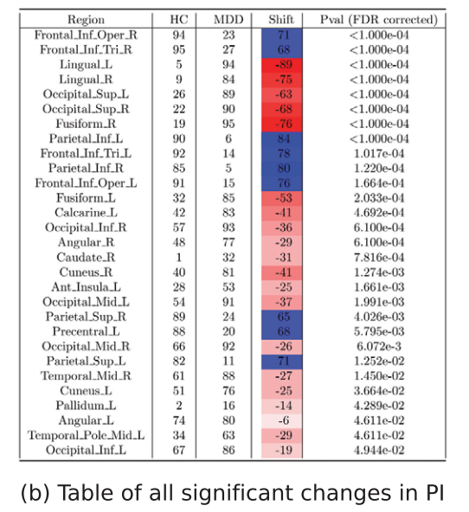
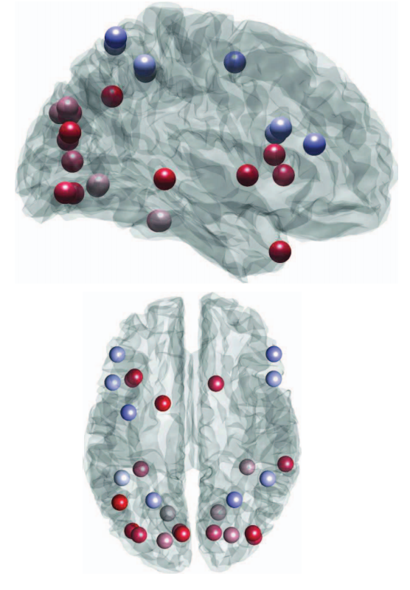
Figure 5: Changes in participation index
Notes:
ROIs that changed in rank order between HC and MDD (p<0:05, FDR corrected). Higher PI scores in the HC and MDD columns represent nodes which contain a higher proportion of connections within the module they belong to

Slide 29
Discussion- Lord et. al
No between group differences detected in whole brain measures of functional organization (path length &small world index)
PI in comparison to other topological measures made the biggest contribution to group diff
Increased inter modular crosstalk for superior frontal and parietal regions in MDD
Increased within module connections of inferior occipital parietal and subcortical regions
Notes:
On the whole, we find that connector nodes in healthy subjects become locally embedded in their communities in major depression.
Finally, we find that these measures provide promising diagnostic information when used in a machine learning algorithm. Just 6 measures are required to yield a very high diagnostic accuracy in our cohort. Moreover, node-wise participation indices dominate amongst all node-wise measures when ranked according to a minimum redundancy, maximum relevance algorithm.
Here the PI would not describe the focal change in activation but rather its different implementation into functional modules, which
may be highly dependent from nodal connectivity changes in other structures.

Slide 30
Common Discussion
Depressed patients can be distinguished from healthy controls using whole-brain RS fMRI with high accuracy and sensitivity
Several regions including Thalamus, ACC, visual and motor related areas were found to have altered FC in MDD in both studies
Cerebellum regions should not be excluded from analysis

Slide 31
What can we learn from these studies?
Look at consensus FCs
Consider normalizing correlation values according to inter-regional distance
Consider using graph metrics for classification
Consider using graph metrics to characterize differences between two resting state sessions (e.g. before and after stress)

